Slide 1
3MTT DATA SCIENCE CAPSTONE PROJECT
Project Title: Predictive Modelling for COVID-19 in Public Health
Presented by: Khadija Muktar Sukola
Fellow ID: FE/23/82197244 Date: November, 2024

Slide 2
Problem Statement
Goal: The objective of this project is to build a machine learning model that predicts the total number of COVID-19 cases in public health based on historical data.
Motivation: The COVID-19 pandemic has caused widespread social, economic, and health-related challenges. The ability to predict the future progression of the pandemic can assist governments, healthcare providers, and the global community in better preparing for future waves, managing resources, and making informed policy decisions. By leveraging machine learning, we can generate accurate predictions based on patterns observed in historical data.

Slide 3
Data Preparation
Data Source: The dataset used in this project is sourced from Kaggle COVID-19 dataset (Worldometer), a trusted platform providing up-to-date and accurate global COVID-19 data. This data includes statistics on the number of confirmed cases, deaths, recoveries, and other relevant features such as population size, number of tests conducted, and healthcare infrastructure.
Data Cleaning:
Missing Values: Missing data was handled by filling gaps with either the median (for numerical data) or the mode (for categorical data).
Column Standardization: Columns were renamed for consistency, and redundant, irrelevant columns were removed to ensure the dataset's clarity and relevance.

Slide 4
Data Preparation
Feature Engineering:
Mortality Ratio: Calculated as Deaths / Total Cases to understand the severity of the virus.
Recovery Ratio: Calculated as Recoveries / Total Cases to assess recovery trends.
Cases per Population: Calculated as Total Cases / Population to normalize case numbers according to population size.
Death Rate per Million: Calculated as Deaths / Population (in millions) to compare death rates across regions.
These engineered features give deeper insight into the pandemic's effects on different regions, helping to inform the model.

Slide 5
Exploratory Data Analysis (EDA)
Total Cases and Deaths by Continent: A bar chart was used to visualize the distribution of total cases and deaths by continent. This allowed us to see how different regions were affected, with Europe and North America having the highest numbers of cases and deaths. Africa and Oceania had relatively fewer cases and deaths, likely due to factors such as population density, healthcare infrastructure, and early intervention measures.
Key Insights from the Bar Chart:
Europe had the highest total confirmed cases and deaths, followed by North America.
Africa, despite its large population, reported fewer cases, which could be due to underreporting or different factors like younger populations or early preventive measures.

Slide 6
Exploratory Data Analysis (EDA)
Correlation Heatmap: A correlation heatmap was generated to show how the various features in the dataset are correlated. The heatmap helped identify which features are most influential in predicting the total number of cases. Key correlations included:
Strong positive correlation between Total Cases and Total Deaths.
Moderate correlation between Testing Rate and Total Cases, indicating that higher testing may lead to more confirmed cases.
Mortality Ratio and Recovery Ratio showed an inverse relationship with Total Cases, indicating that higher case numbers typically come with higher mortality rates and lower recovery rates.

Slide 7
Machine Learning Model
Model Selection: For this project, we chose the Random Forest Regressor, an ensemble learning method that constructs multiple decision trees to predict a numerical outcome. This model is suitable for regression tasks, where the goal is to predict continuous values, such as the total number of COVID-19 cases.
Why Random Forest?
Accuracy: Random Forest typically provides high accuracy, even when there is a complex relationship between the features.
Handling Non-Linear Data: It can effectively handle non-linear data and interactions between different features.
Reduced Overfitting: Random Forest reduces overfitting by averaging the results of multiple decision trees, which makes it robust in making predictions.

Slide 8
Machine Learning Model cont
Evaluation Metrics:
RMSE (Root Mean Squared Error): This metric was used to assess the magnitude of the errors in predictions. A lower RMSE indicates better accuracy.
R² Score: The R² score measures how well the model explains the variance in the data. An R² score closer to 1 indicates a better fit to the data.
Model Training and Hyperparameter Tuning: We trained the Random Forest model using the cleaned and processed dataset. Hyperparameters such as the number of trees and the depth of the trees were optimized using cross-validation to prevent overfitting.

Slide 9
Results and Insights
Model Performance:
Cross-validated RMSE: 431,147.87
This value represents the root mean squared error computed through cross-validation, showing the general error level across different subsets of the data. A high RMSE indicates a significant error range between predicted and actual values during validation.
Model RMSE: 8,936.74
The RMSE of the trained model indicates a relatively low error in the model’s predictions. Since it is a much smaller number than the cross-validated RMSE, this shows that the model performed well on the test set, with predictions being relatively close to actual values.
Model R² Score: 0.9871
This is an excellent result. With an R² score of 98.71%, the model explains 98.71% of the variance in the data, showing a very high degree of accuracy in predicting the total COVID-19 cases.
Model Accuracy: 98.71%
This represents the percentage of correct predictions made by the model. A 98.71% accuracy suggests that the model is very effective at forecasting the total number of cases.

Slide 10
Results and Insights cont
Best Hyperparameters:
max_depth: None
min_samples_leaf: 1
min_samples_split: 2
n_estimators: 100
These hyperparameters were identified through cross-validation and optimized for the best model performance. They helped ensure the model was both accurate and generalizable.
Insights
The Random Forest model has demonstrated remarkable predictive accuracy, with an R² score nearing 1, indicating that the model performs exceptionally well in predicting global COVID-19 trends.
The model’s accuracy and low RMSE suggest it is suitable for practical use in making COVID-19 predictions at global and regional levels.

Slide 11
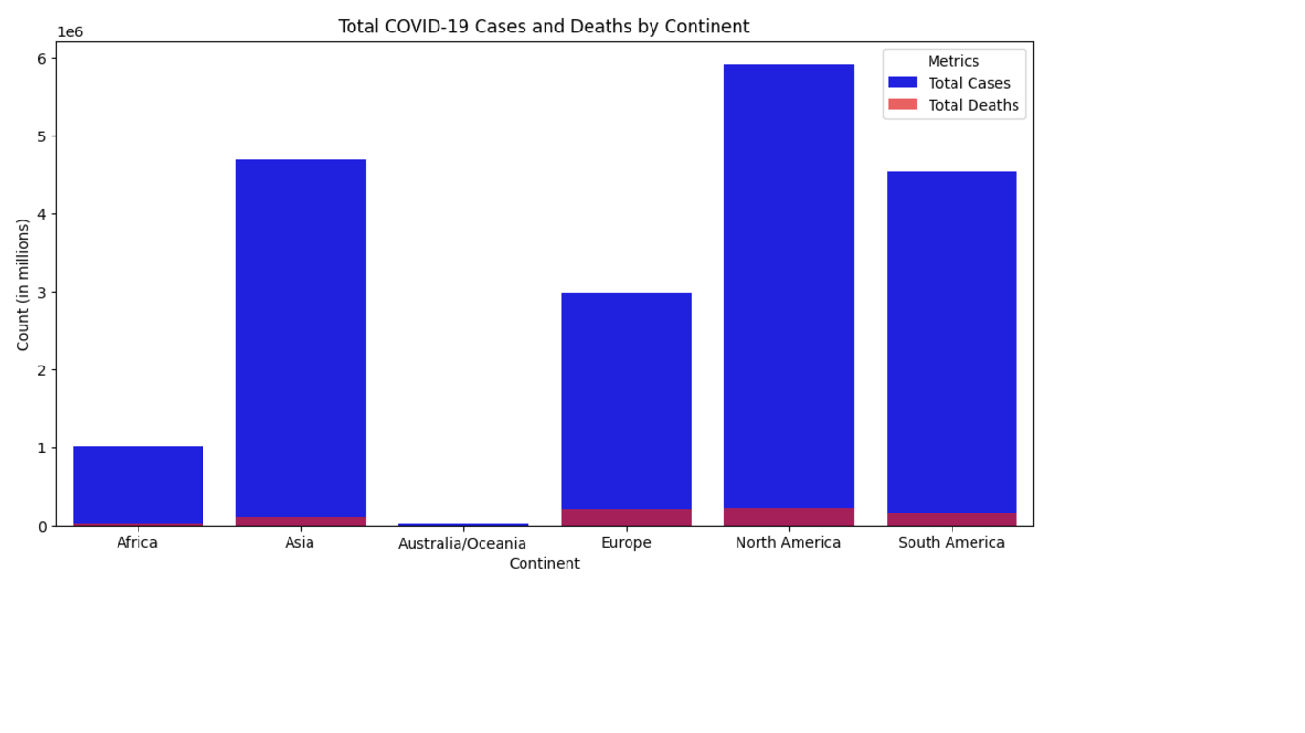
VISUALS

Slide 12
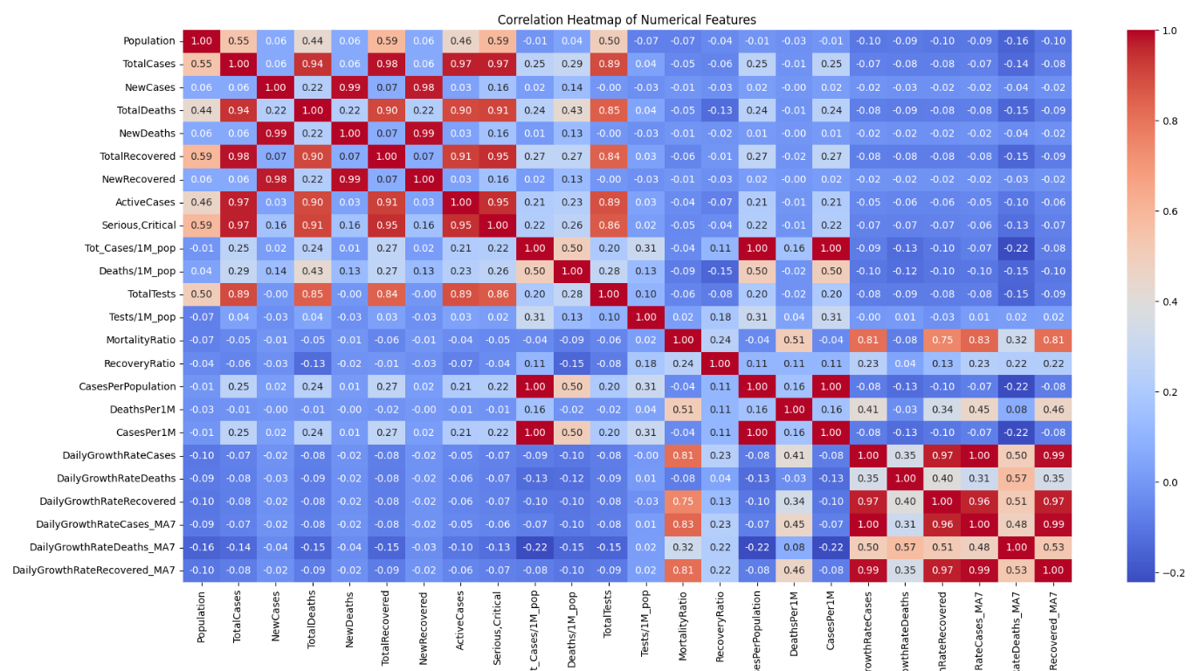
VISUALS

Slide 13
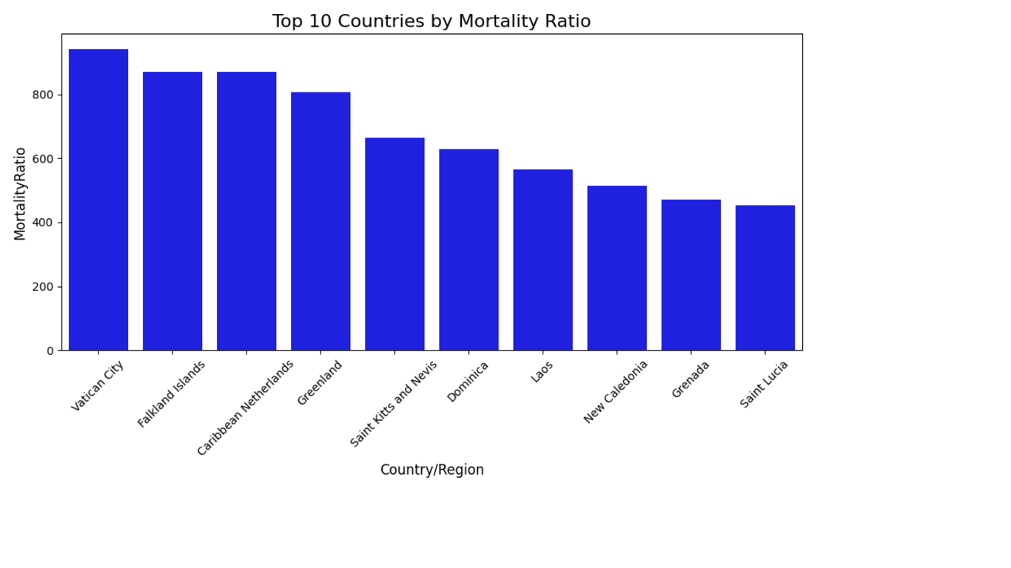
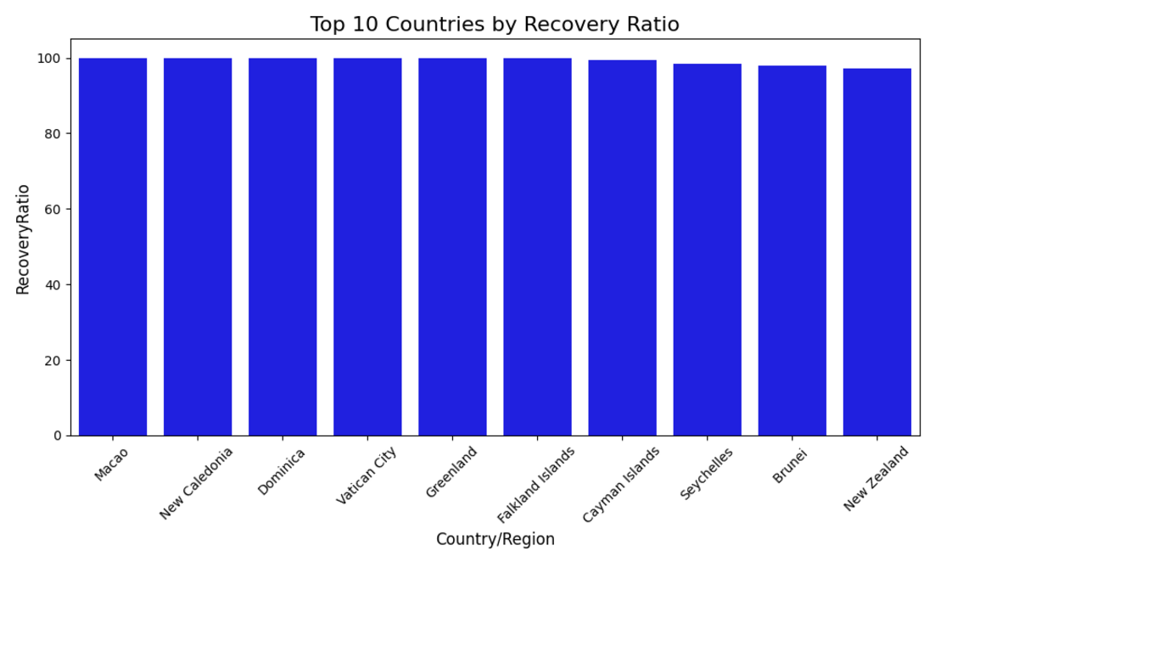
VISUALS

Slide 14
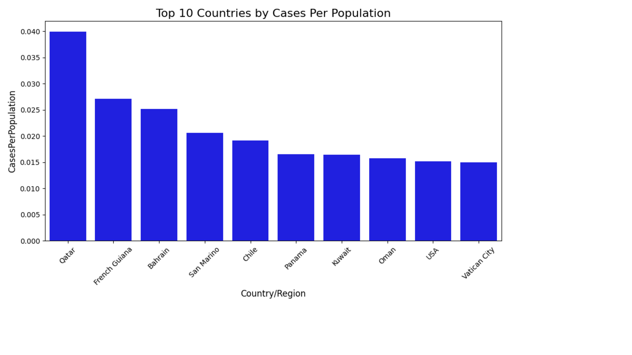
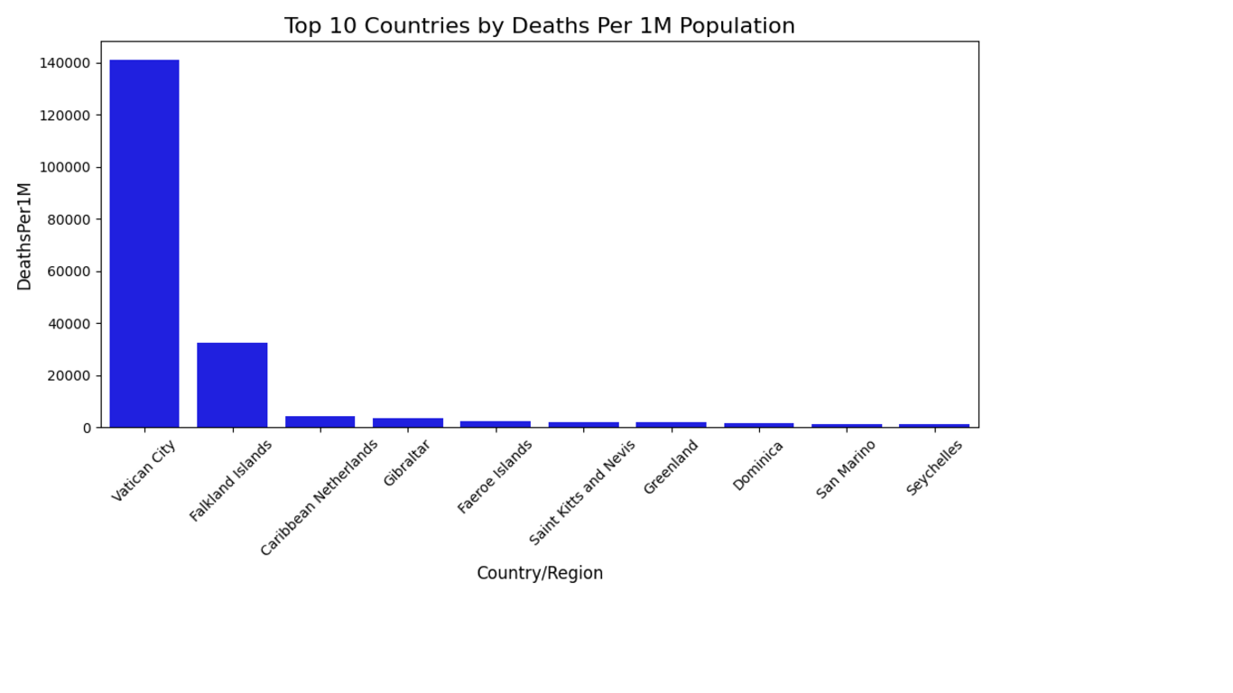
VISUALS

Slide 15

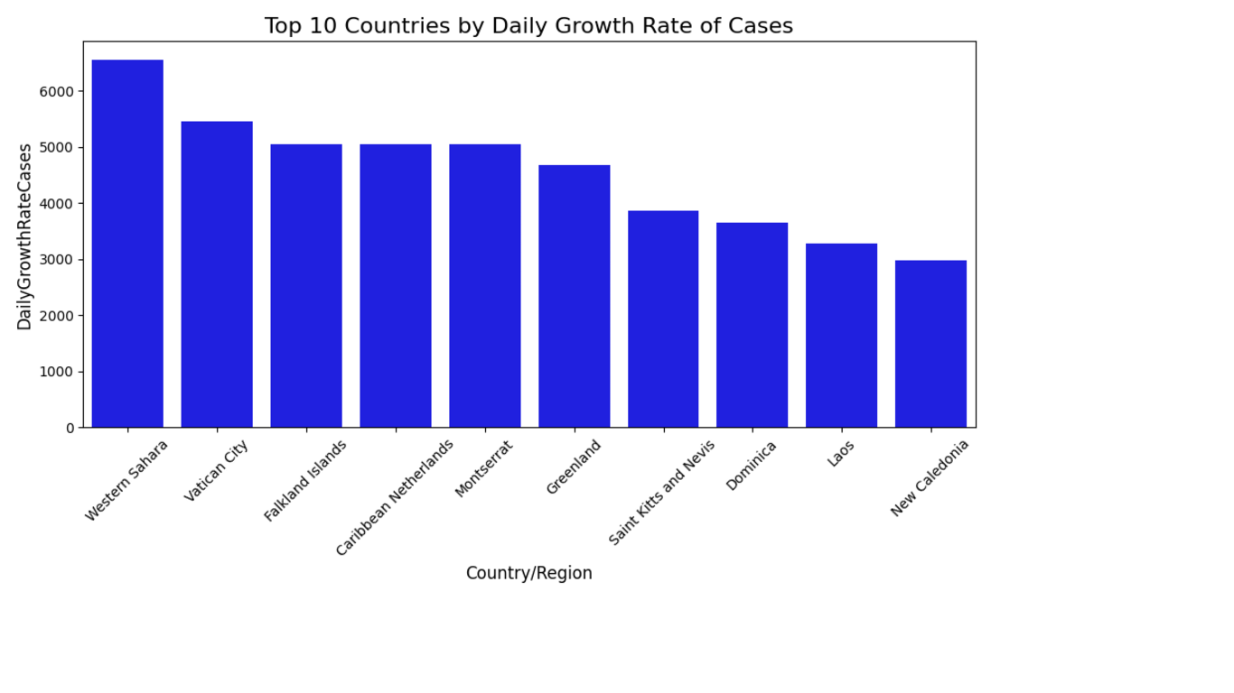
VISUALS

Slide 16
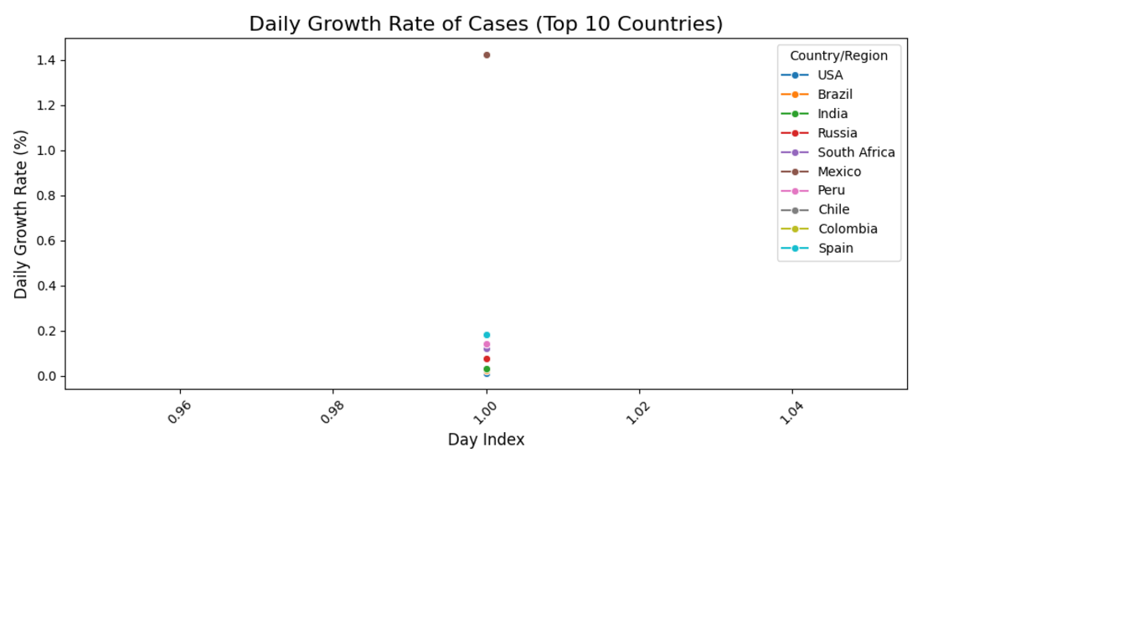
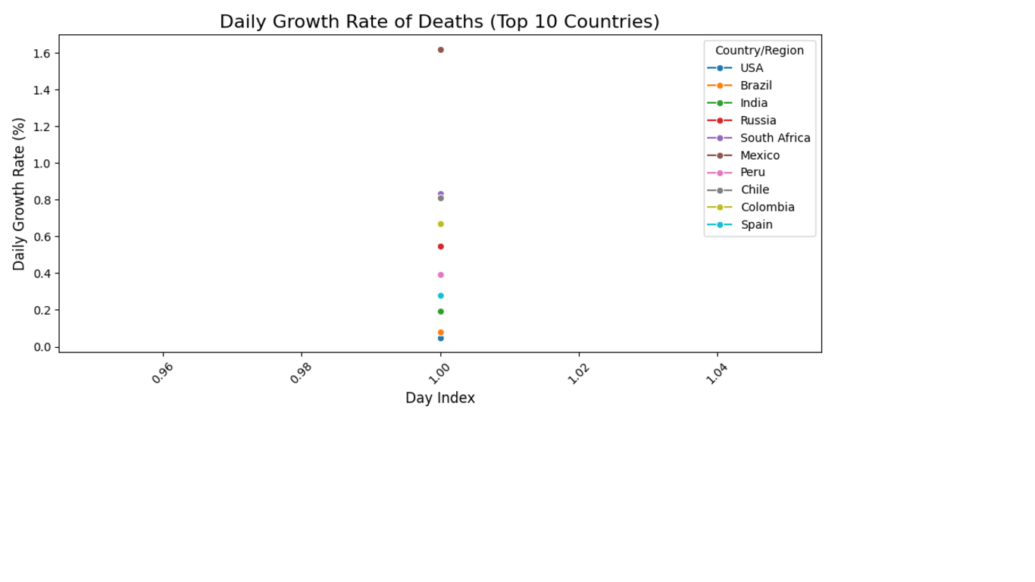
VISUALS

Slide 17
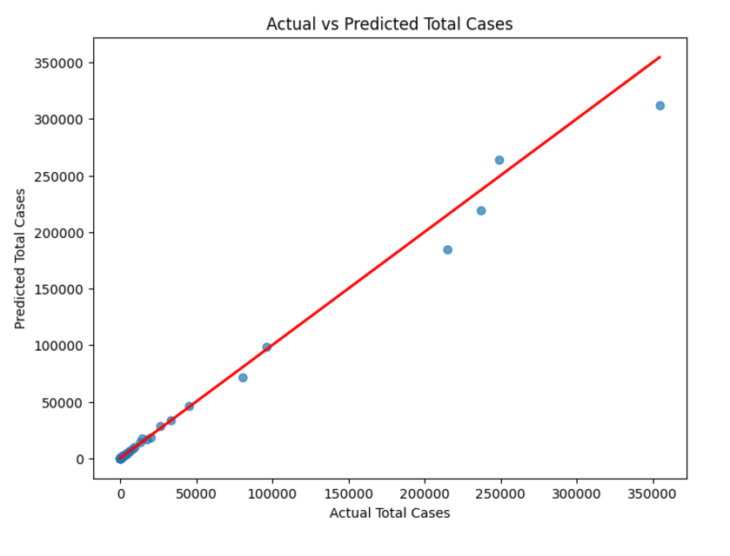

VISUALS

Slide 18
Conclusion
Summary: This project successfully built a highly accurate machine learning model for predicting global COVID-19 cases. Using Random Forest Regressor, I optimized the model using the best hyperparameters, achieving an R² score of 0.9871 and 98.71% accuracy. The model's performance suggests it can effectively predict future cases based on historical data.
Future Work:
Real-Time Data Integration: To enhance the model, incorporating real-time data (such as vaccination rates, new variants, or government interventions) would provide more timely and accurate predictions.
Time-Series Forecasting: Adding a time-series element, where predictions are based on past trends and time-based features, could improve long-term predictions and detect potential future surges.
Feature Expansion: Incorporating more diverse features such as healthcare quality, testing rates, and socioeconomic factors might further refine the model’s predictions.
Model Comparison: Testing alternative machine learning models, such as XGBoost or LSTM (Long Short-Term Memory) models for sequential data, could help assess if other models might provide better predictions for specific regions or timeframes.
Final Thoughts: The success of the model, with a high R² score and accuracy, demonstrates the potential of machine learning in managing and forecasting the course of global health crises like the COVID-19 pandemic. With more real-time data and continuous updates, this model could be a valuable tool in global pandemic management and preparedness strategies.

Slide 19
THANK YOU
Khadija Muktar Sukola
FE/23/82197244

